Slide 1
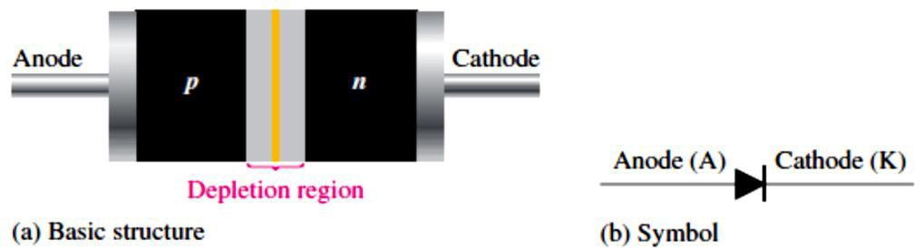
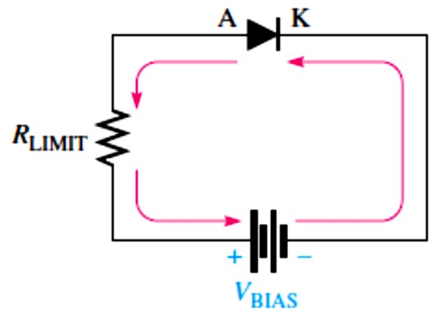
Lecture 2: Diodes and applications
In Lecture 1, we learned that many semiconductor devices are based on the pn junction.
In this Lecture, the operation and characteristics of the diode are covered. Also, three diode models representing three levels of approximation are presented and testing is discussed.
2.1 Diode Operation
A diode is a two-terminal semiconductor device formed by two doped regions of silicon separated by a pn junction. The most common category of diode, known as the general- purpose diode. Other names, such as rectifier diode or signal diode, depend on the particular type of application for which the diode was designed.
The basic diode structure and schematic symbol are shown in Figure 2-1.
FIGURE 2-1: The diode.
There is current through a diode only when it is forward-biased. Ideally, there is no current when there is no bias nor when there is reverse bias. Actually, there is a very small current in reverse bias due to the thermally generated minority carriers, but this can usually be neglected.
Forward Bias: permits majority-carrier current, a diode connected for forward bias is shown in Figure 2-2.
  Bias voltage (�_{BIAS}) connections: positive to anode (A); negative to cathode (K).
  The �_{BIAS} must be greater than the barrier potential.
  Barrier potential (�� ): 0.7 V for silicon.
  Majority carriers provide the forward current.
  The depletion region narrows.
FIGURE 2-2:A diode connected for forward bias.
Reverse Bias: prevents majority-carrier current, a diode connected for reverse bias is shown in Figure 2-3.

Slide 2
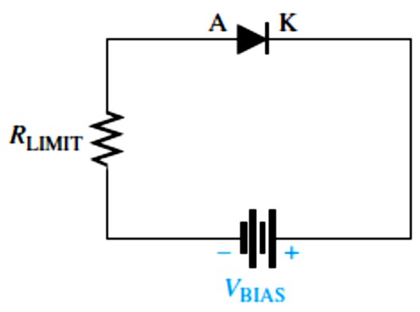
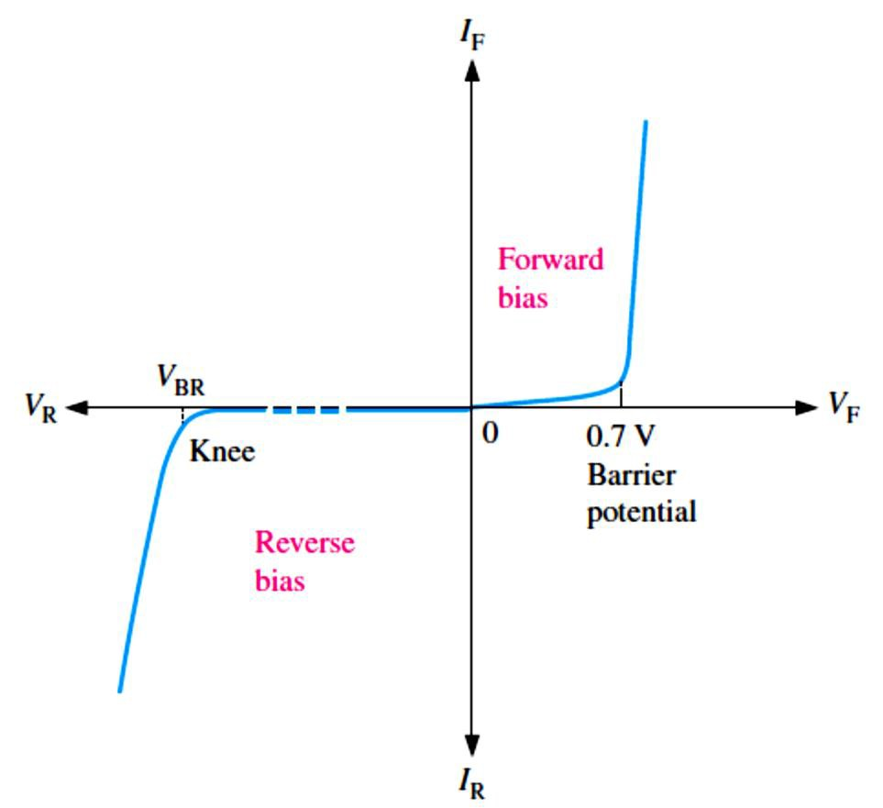
Bias voltage (�_{BIAS}) connections: positive to cathode (K); negative to anode (A).
The �_{BIAS} must be less than the breakdown voltage (�_{BR}).
  Avalanche occurs in a reverse-biased diode if the �_{BIAS} equals or exceeds the �_{BR}.
There is no majority carrier current after transition time.
Minority carriers provide a negligibly small reverse current.
The depletion region widens.
The �_{BR} for a diode is typically greater than 50 V.
FIGURE 2-3: A diode connected for reverse bias.
2.2 Voltage-Current Characteristic of a Diode
The V-I characteristic curve, as shown in Figure 2-4, shows the diode current as a function of voltage across the diode.
The resistance of a forward-biased diode is called the dynamic or ac resistance (𝑟′� =
∆�_{𝐹}⁄∆𝐼_{𝐹}). Where �_{𝐹}and 𝐼_{𝐹}are the forward voltage and current across the diode, respectively.
Reverse current (𝐼_{R}) increases rapidly at the reverse �_{BR}.
Reverse breakdown should be avoided in most diodes.
FIGURE 2-4: The V-I characteristic curve for a diode.

Slide 3
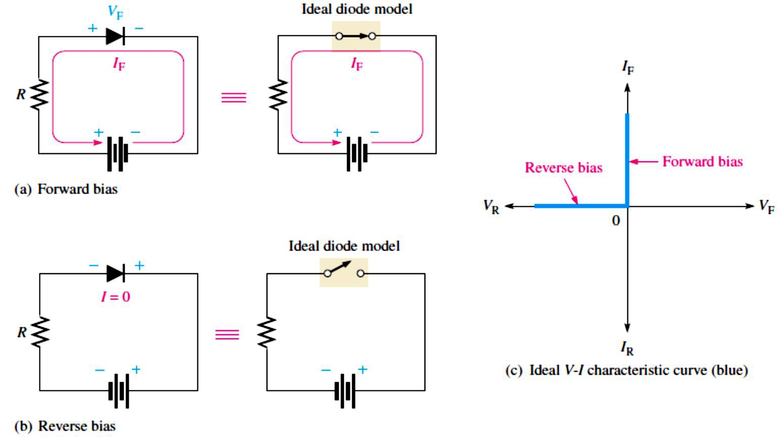
2.3 Diode Models
The ideal diode model, as shown in Figure 2-5, represents the diode as a closed (on) switch in forward bias and as an open (off) switch in reverse bias.
Since the �� and the 𝑟′� are neglected, then the �_{𝐹}is zero (�_{F} =0 V).
The 𝐼_{F} is determined by the �_{BIAS} and the limiting resistor (𝑅_{LIMIT}) using Ohm’s law.
^{𝐼}F ^{= �}BIAS^{⁄𝑅}LIMIT
Equation 2-1
Since the 𝐼_{R} is neglected, its value is assumed to be zero.
𝐼_{R} =0 A
The reverse voltage (�_{R}) equals the �_{BIAS}. �_{R} = �_{BIAS}
We may want to use the ideal diode model when we are troubleshooting or trying to figure out the operation of a circuit and are not concerned with more exact values of voltage or current.
FIGURE 2-5: The ideal model of a diode.
The practical diode model includes the barrier potential (�� ), as shown in Figure 2-6, represents the diode as a closed (on) switch in forward bias in series with a small equivalent voltage source (�_{F}) equal to the �� =0.7 V and as an open (off) switch in reverse bias just as in the ideal model.
Since the �� is included and the 𝑟′� is neglected, then:
�_{F} =0.7 V

Slide 4
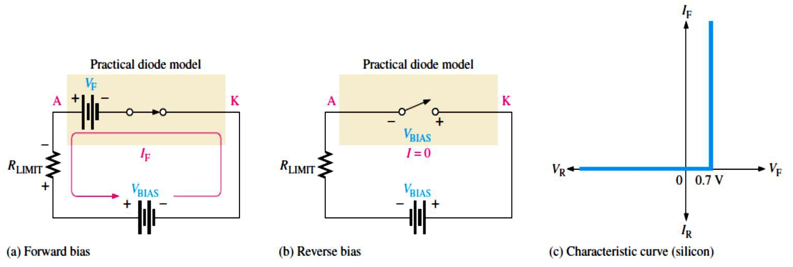
The 𝐼_{F} is determined as follows by first applying Kirchhoff’s voltage law to Figure 2-6(a):
�_{BIAS} − �_{F} − �_{𝑅LIMIT} = 0
�𝑅_{LIMIT} ^{= 𝐼}F ^{𝑅}LIMIT
Substituting and solving for 𝐼_{F},
�_{F} =
�BIAS^{−�}F
Equation 2-2
𝑅
LIMIT
The diode is assumed to have zero reverse current.
𝐼_{R} =0 A
�R ^{= �}BIAS
The practical diode model is useful when we are troubleshooting in lower-voltage circuits. In these cases, the 0.7 V drop across the diode may be significant and should be taken into account. The practical model is also useful when we are designing basic diode circuits.
FIGURE 2-6: The practical model of a diode.
The complete diode model, as shown in Figure 2-7, is the most accurate approximation that includes the small 𝑟′� in series with the practical model in forward bias and the large internal reverse resistance (𝑟′_{R}) in parallel with the open switch in reverse bias.
Since the �� and the 𝑟′� are included, then:
�_{F} = 0.7V + 𝐼_{F} 𝑟′�
𝐼_{F} = _{𝑅}
�_{BIAS} − 0.7V
+ 𝑟′
LIMIT �
The 𝐼_{R} is taken into account with the parallel resistance.
For troubleshooting work, it is unnecessary to use the complete model, as it involves complicated calculations. This model is generally suited to design problems using a computer for simulation.

Slide 5
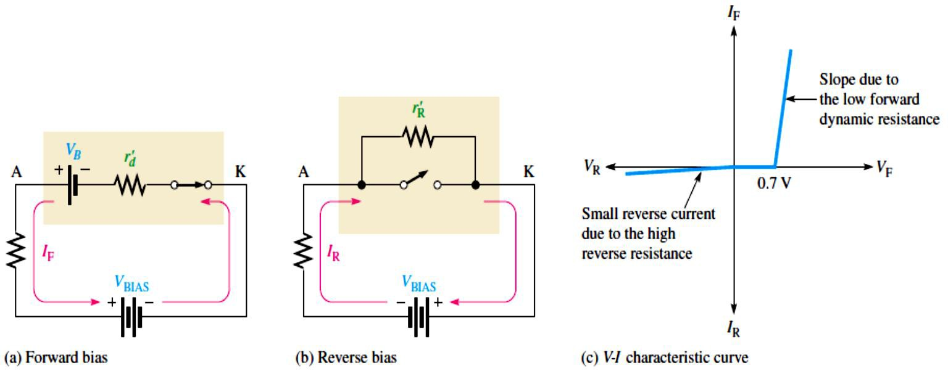
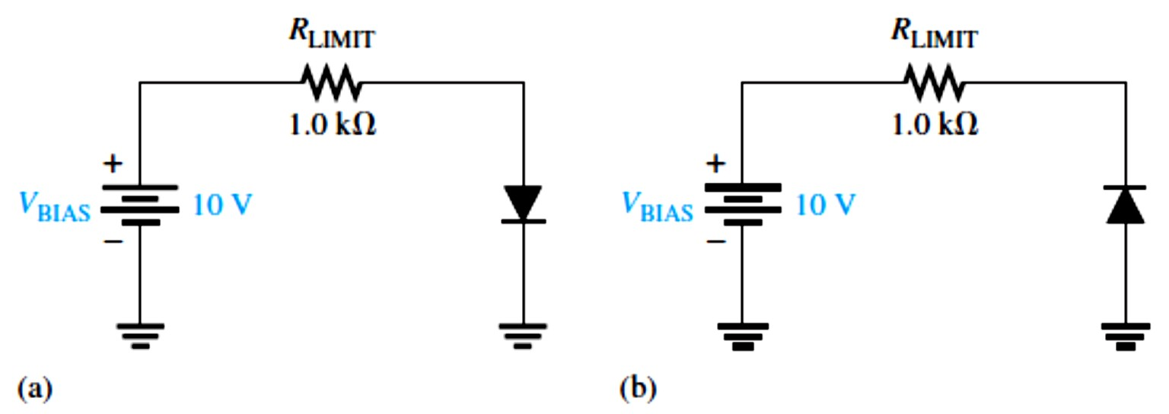
FIGURE 2-7: The complete model of a diode.
EXAMPLE 2-1:
Determine the forward voltage and forward current for the diode in Figure 2-8(a) for each of the diode models. Also find the voltage across the limiting resistor in each case. Assume 𝑟′�=10Ω at the determined value of forward current.
Determine the reverse voltage and reverse current for the diode in Figure 2-8(b) for each of the diode models. Also find the voltage across the limiting resistor in each case. Assume 𝐼_{R} = 1 𝜇A.
FIGURE 2-8
Solution (a) Ideal model:
�_{F} = 0 V
𝐼_{F} = _{𝑅}
�BIAS
10V
= = 10 mA
1.0 kΩ
LIMIT
�_{𝑅LIMIT} = 𝐼_{F} 𝑅_{LIMIT} = (10 mA)(1.0 kΩ) = 10V
�_{F} =0.7 V
Practical model:
𝐼_{F} =
�BIAS ^{− �}F
=
10 V − 0.7 V
9.3 V
= _{1.0 kΩ} = 9.3 mA
𝑅
LIMIT
1.0 kΩ
�_{𝑅LIMIT} = 𝐼_{F} 𝑅_{LIMIT} = (9.3 mA)(1.0 kΩ) = 9.3 V

Slide 6
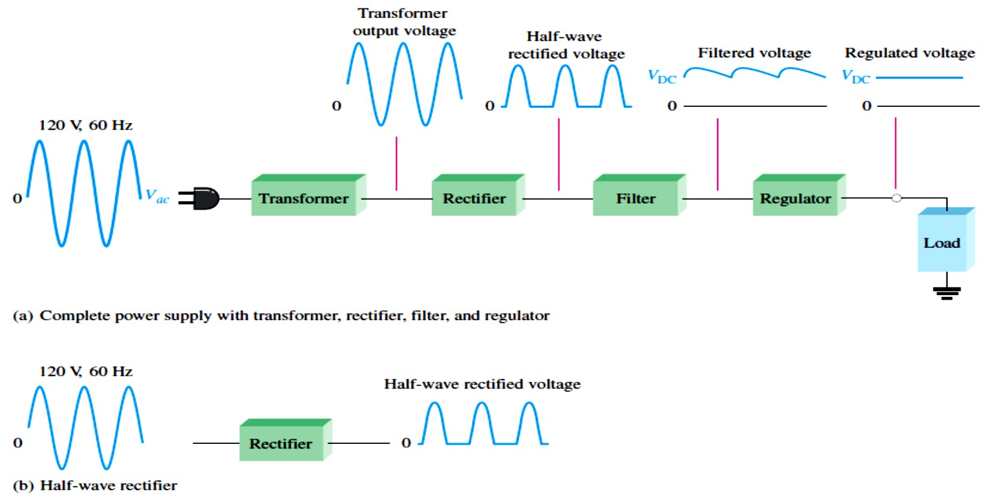
Complete model: 𝐼_{F} = _{𝑅}
�_{BIAS}−0.7V
10 V −0 .7 V 9 . 3 V
LIMIT 𝑑
= = = 9.21 mA
+�′ 1.0 kΩ+10 Ω 1010 Ω
�_{F} = 0.7V + 𝐼_{F} 𝑟′� = 0.7 V + (9.21 mA)(10 Ω) = 792 mV
�_{𝑅LIMIT} = 𝐼_{F} 𝑅_{LIMIT} = (9.21 mA)(1.0 kΩ) = 9.21 V
𝐼_{R} = 0 A
�_{R} = �_{BIAS} = 10 V
^{�𝑅}LIMIT ^{= 0 V}
𝐼_{R} = 0 A
�_{R} = �_{BIAS} = 10 V
^{�𝑅}LIMIT ^{= 0 V}
𝐼_{R} = 1 𝜇A
�_{𝑅LIMIT} = 𝐼_{R} 𝑅_{LIMIT} = (1 𝜇A)(1.0 kΩ) = 1 mV
�_{R} = �_{BIAS} − �_{𝑅LIMIT} = 10 V − 1 mV = 9.999 V
(b) Ideal model:
Practical model:
Complete model:
2.4 Half-Wave Rectifiers
Because of their ability to conduct current in one direction and block current in the other direction, diodes are used in circuits called rectifiers that convert ac voltage into dc voltage.
Rectifiers are found in all dc power supplies that operate from an ac voltage source.
The dc power supply typically consists of a transformer, a diode rectifier, a filter, and a regulator as shown in Figure 2-9.
FIGURE 2-9: Block diagram of a dc power supply with a load and a rectifier.

Slide 7
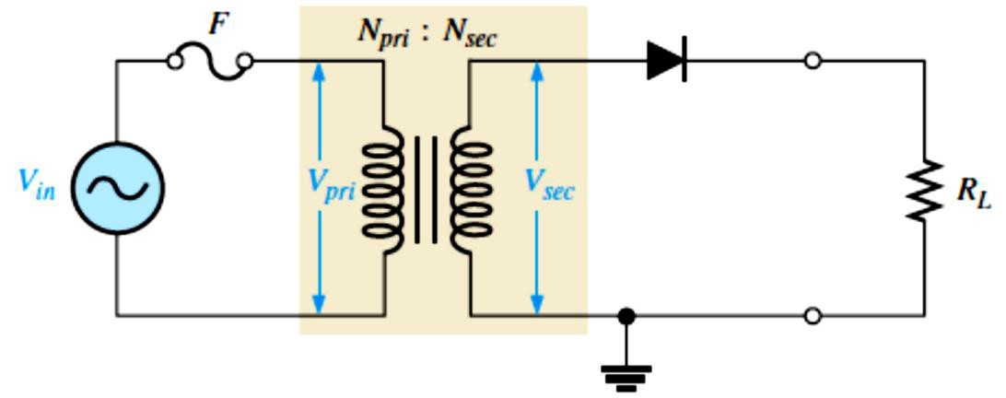
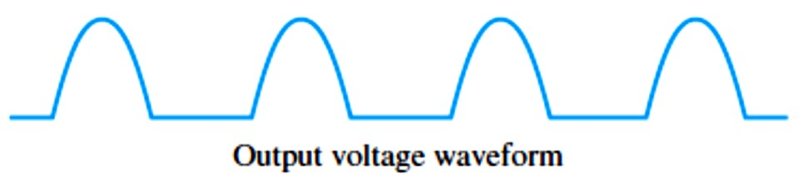
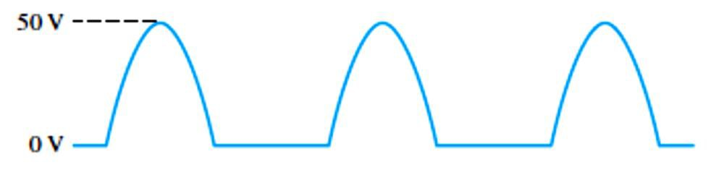
Figure 2-10 illustrates the process called half-wave rectification.
The single diode in a half-wave rectifier is forward-biased and conducts for 180° of the input cycle.
The output frequency of a half-wave rectifier equals the input frequency.
The average value of output voltage:
�AVG ^{= �}�(���)^{⁄𝜋}
Equation 2-3
This equation shows that �_{AVG} is approximately 31.8% of �� for a half-wave rectified voltage.
The peak value of output voltage:
��(���) ^{= �}�(���) ^{− 0.7V}
Equation 2-4
The secondary voltage (���� ) of a transformer equals the turns ratio, n, times the primary voltage (�_{��𝑖}).
���� ^{= 𝑛�}��𝑖
The diode peak inverse voltage (PIV) is the maximum voltage appearing across the diode in
reverse bias.
^{PIV = �}�(���)
Equation 2-5
A diode should be rated at least 20% higher than the PIV.
FIGURE 2-10: Half-wave rectifier with transformer-coupled input voltage.
EXAMPLE 2-2: What is the average value of the half-wave rectified voltage in Figure 2-11?
FIGURE 2–22

Slide 8
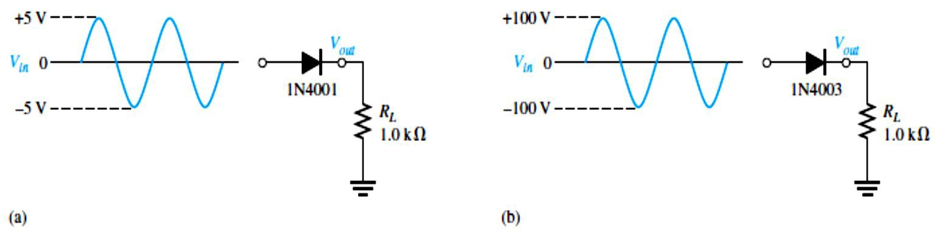
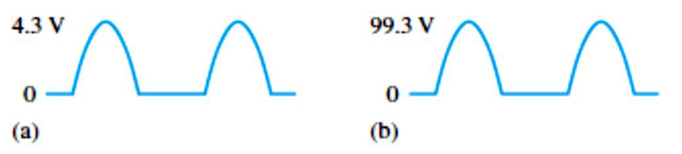
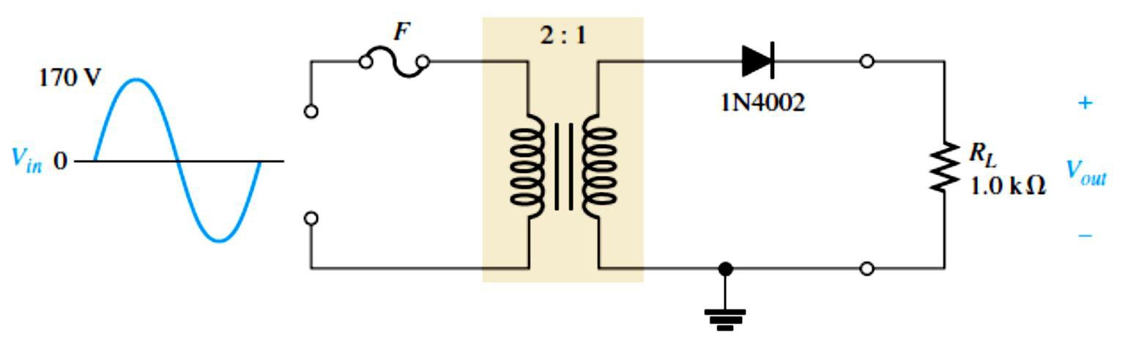
�_{𝑃} 50 V
𝜋𝜋
Solution
�AVG ⁼
=
= 15.9 V
Notice that �_{AVG} is 31.8% of �� [(31.8/100) × 50V = 15.9V].
EXAMPLE 2-3: Draw the output voltages of each rectifier for the indicated input voltages, as shown in Figure 2-12. The 1N4001 and 1N4003 are specific rectifier diodes.
FIGURE 2-12
Solution The peak output voltage for circuit (a) is
�_{�(���)} = �_{�(𝑖�)} − 0.7 V = 5 V − 0.7 V = 4.30 V
The peak output voltage for circuit (b) is �_{�(���)} = �_{�(𝑖�)} − 0.7 V = 100 V − 0.7 V = 99.3 V
The output voltage waveforms are shown in Figure 2-13. The barrier potential could have been
neglected in circuit (b) with very little error (error = ^{100 V−99.3 V} × 100% = 0.7 percent); but, if
100 V
it is neglected in circuit (a), a significant error results (error = ^{5 V−4.3 V} × 100% =14 percent).
5 V
FIGURE 2-13: Output voltages for the circuits in Figure 2-12. They are not shown on the same scale.
EXAMPLE 2-4: Determine the peak value of the output voltage for Figure 2-14 if the turns ratio is 0.5.
FIGURE 2-14
Solution
��(��𝑖) ^{= �}�(𝑖�) ^{= 170 V}

Slide 9
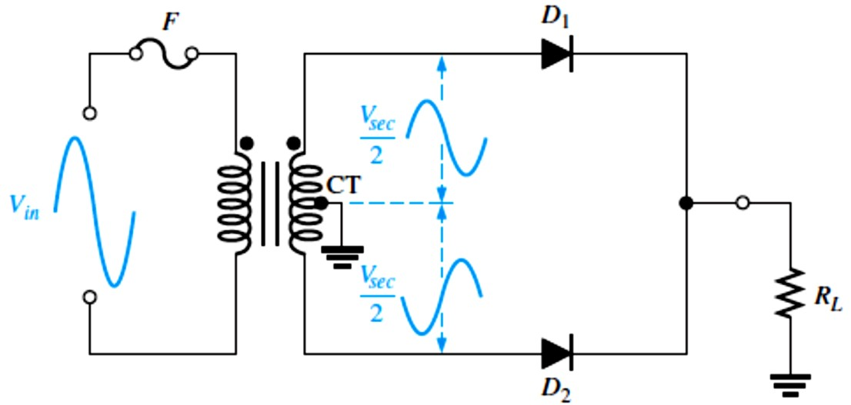
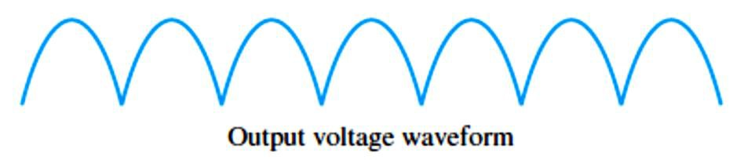
The peak secondary voltage is
�_{�(sec)} = 𝑛�_{�(��𝑖)} = 0.5 (170 V) = 85 𝑉
The rectified peak output voltage is
�_{�(���)} = �_{�(���)} − 0.7 V = 85 V − 0.7 V = 84.3 V
where �_{�(sec)} is the input to the rectifier.
2.5 Full-Wave Rectifiers
The full-wave rectifier is the most commonly used type in dc power supplies.
Each diode in a full-wave rectifier is forward-biased and conducts for 180° of the input cycle.
The output frequency of a full-wave rectifier is twice the input frequency.
�_{AVG} is approximately 63.7% of �� for a full-wave rectified voltage
The two basic types of full-wave rectifier are center-tapped and bridge.
Center-Tapped Full-Wave Rectifier is shown in Figure 2-15:
  The average value of output voltage:
�AVG ⁼
^{2�}�(���)
Equation 2– 6
𝜋
The peak value of output voltage:
��(���) ⁼
��(���)
− 0.7V
Equation 2– 7
2
The diode peak inverse voltage:
PIV = 2�_{�(���)} + 0.7V
Equation 2– 8
FIGURE 2-15: A center-tapped full-wave rectifier

Slide 10
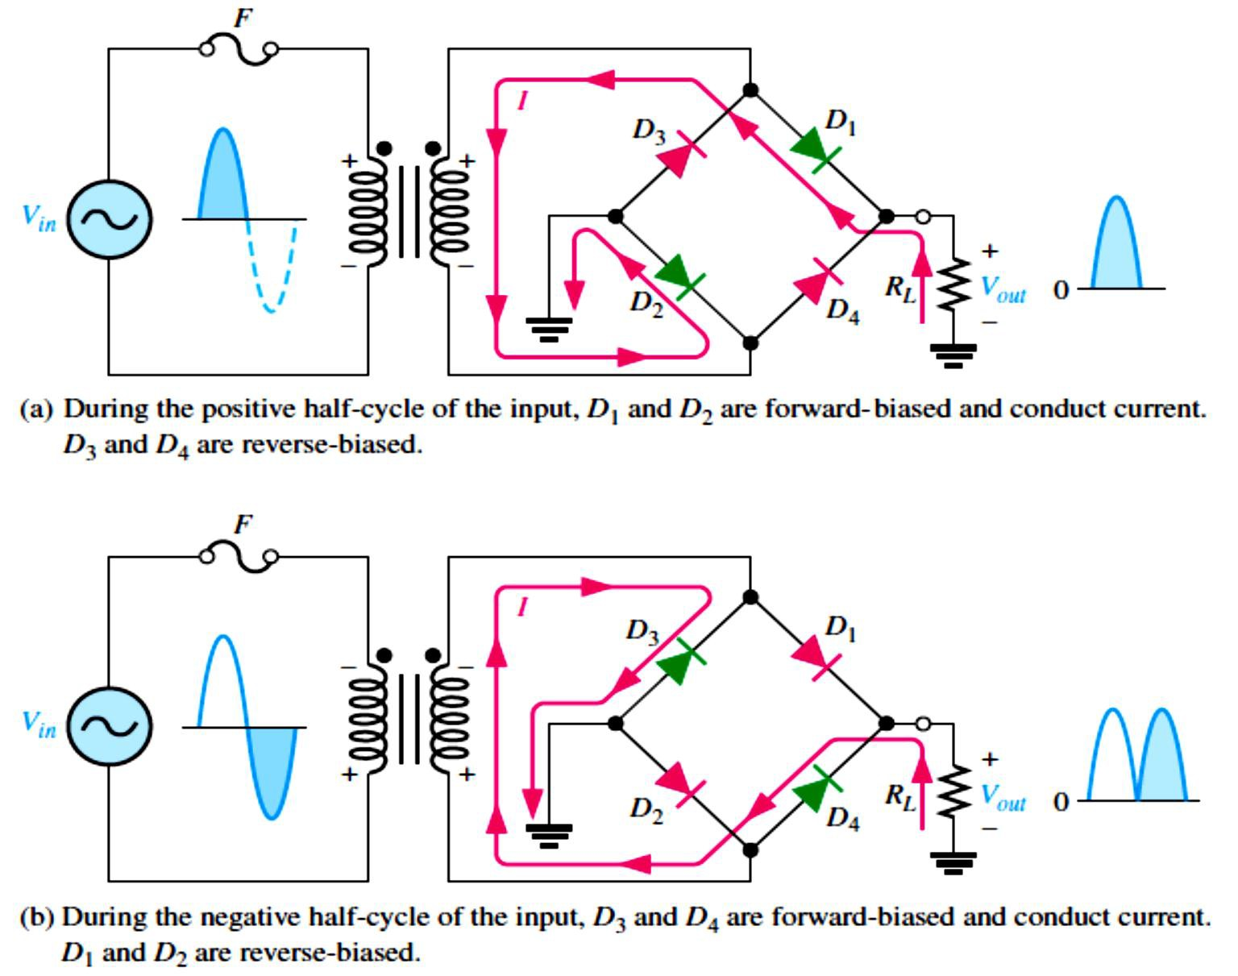
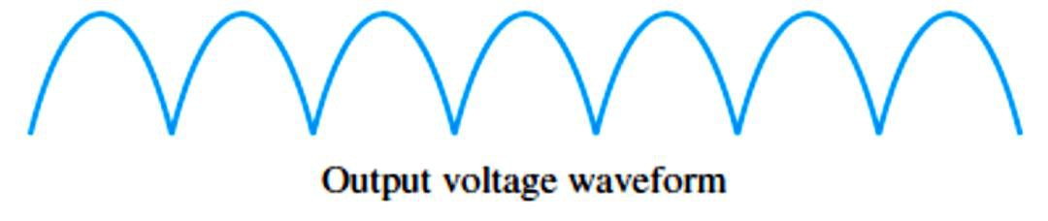
Bridge Full-Wave Rectifier is shown in Figure 2-16:
  The average value of output voltage:
�AVG ⁼
^{2�}�(���)
Equation 2– 6
𝜋
The peak value of output voltage:
��(���) ^{= �}�(���) ^{− 1.4V}
The diode peak inverse voltage:
PIV = �_{�(���)} + 0.7V
Equation 2– 9
Equation 2– 10
FIGURE 2-16: Operation of a bridge rectifier.
10

Slide 11
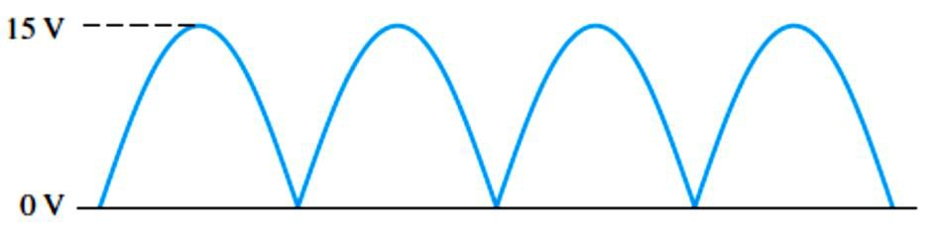
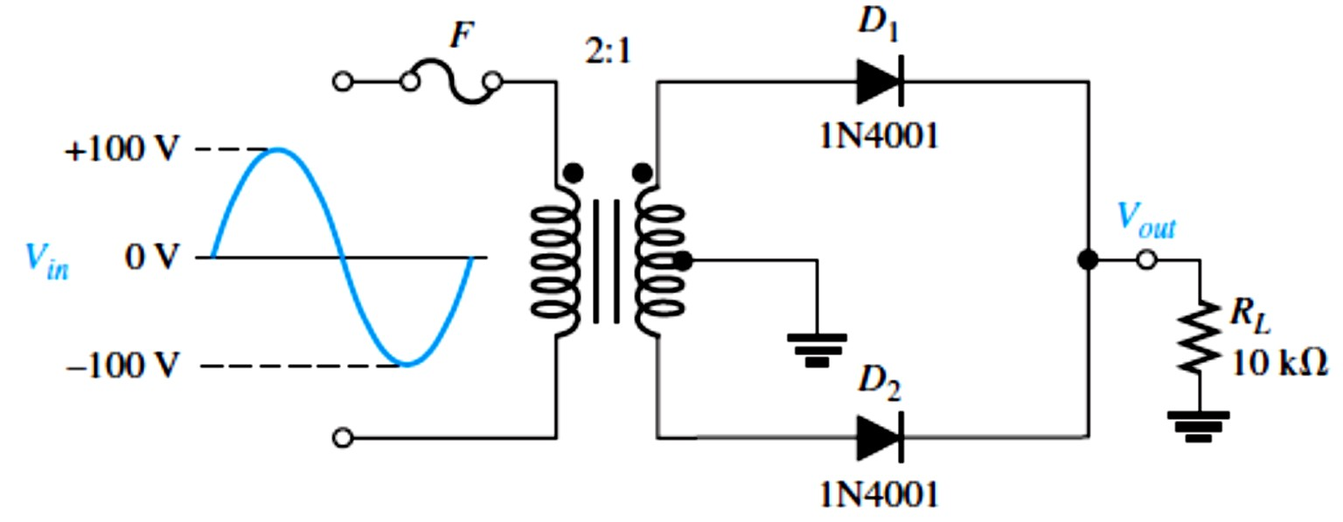
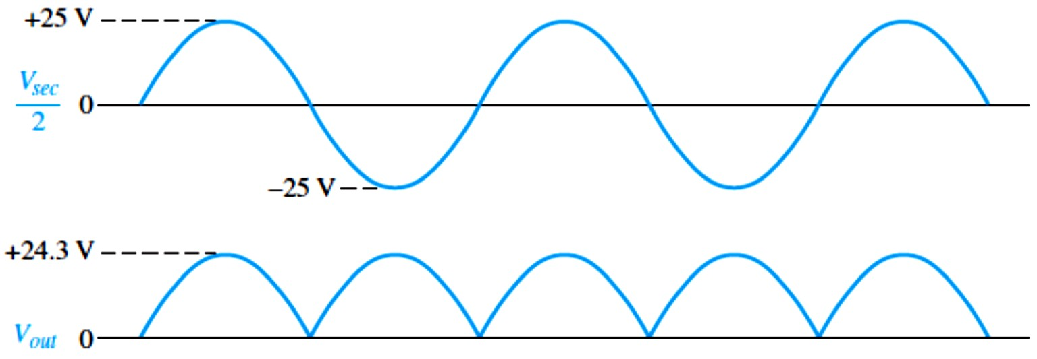
EXAMPLE 2-5: Find the average value of the full-wave rectified voltage in Figure 2-17.
FIGURE 2-17
Solution
2��
2(15 V)
�AVG ⁼
= = 9.55 V
𝜋𝜋
�_{AVG} is 63.7% of �� .
EXAMPLE 2-6: (a) Show the voltage waveforms across each half of the secondary winding and across 𝑅_{𝐿}when a 100 V peak sine wave is applied to the primary winding in Figure 2-18. (b) What minimum PIV rating must the diodes have?
FIGURE 2-18
Solution (a) The transformer turns ratio n = 0.5. The total peak secondary voltage is
�_{�(���)} = 𝑛𝑉_{𝑃(𝑝𝑟𝑖)} = 0.5(100 V) = 50 V
There is a 25 V peak across each half of the secondary with respect to ground. The output load voltage has a peak value of 25 V, less the 0.7 V drop across the diode. The waveforms are shown in Figure 2-19.
FIGURE 2-19
(b) Each diode must have a minimum PIV rating of
PIV = 2 �_{�(���)} + 0.7V = 2(24.3 V) + 0.7 V = 49.3 V

Slide 12
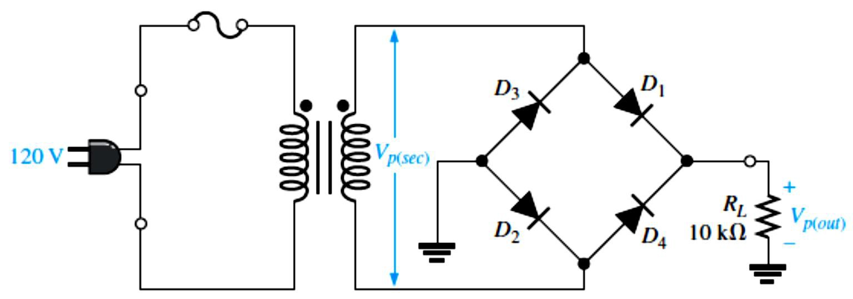
EXAMPLE 2-7: Determine the peak output voltage for the bridge rectifier in Figure 2-20. Assuming the practical model, what PIV rating is required for the diodes? The transformer is specified to have a 12 V rms secondary voltage for the standard 120 V across the primary.
FIGURE 2-20
Solution The peak output voltage (taking into account the two diode drops) is
�_{�(���)} = 1.414 V��� = 1.414 (12V) ≅ 17 V
�_{�(���)} = �_{�(���)} − 1.4V = 17V − 1.4V = 15.6 V
The PIV rating for each diode is
PIV = �_{�(���)} + 0.7V = 15.6V + 0.7V = 16.3 V
2.6 Power Supply Filters and Regulators
A power supply filter ideally eliminates the fluctuations in the output voltage of a half-wave or full-wave rectifier and produces a constant-level dc voltage.
Filtering is necessary because electronic circuits require a constant source of dc voltage and current to provide power and biasing for proper operation.
Filters are implemented with capacitors.
Voltage regulation in power supplies is usually done with integrated circuit voltage regulators.
A voltage regulator prevents changes in the filtered dc voltage due to variations in input voltage or load.
A capacitor-input filter provides a dc output approximately equal to the peak of its rectified input voltage.
Ripple voltage is caused by the charging and discharging of the filter capacitor, as illustrated in Figure 2-21.
The smaller the ripple voltage, the better the filter action.
The ripple factor (r) is an indication of the effectiveness of the filter and is defined as
𝑟=
��(��)
Equation 2– 11
���
where �_{�(��)} is the peak-to-peak ripple voltage and ��� is the dc (average) value of the filter’s output voltage, as illustrated in Figure 2-22.

Slide 13
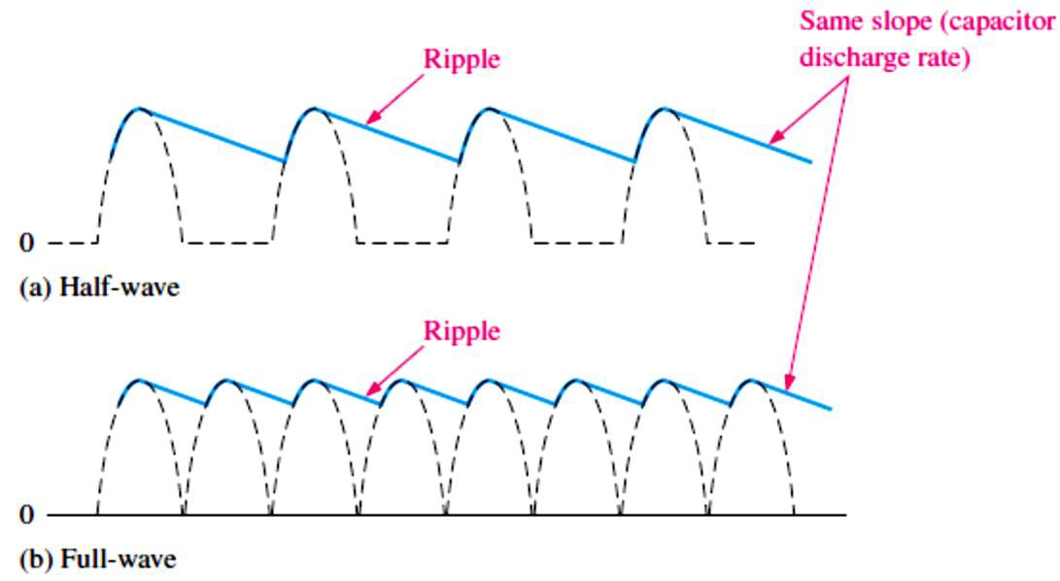
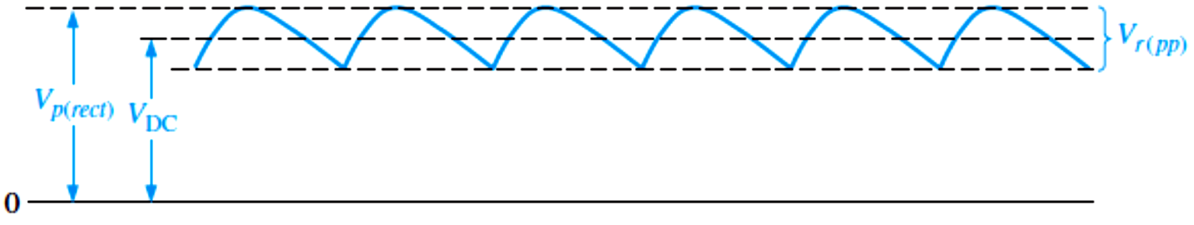
FIGURE 2-21: Comparison of ripple voltages for half-wave and full-wave rectified voltages with the same filter capacitor and load and derived from the same sinusoidal input voltage.
FIGURE 2–22: �� and ��� determine the ripple factor.
For a full-wave rectifier with a capacitor-input filter, approximations for the peak-to-peak ripple voltage, �_{�(��)}, and the dc value of the filter output voltage, ��� , are given in the following equations. The variable �_{�(����)} is the unfiltered peak rectified voltage. If 𝑅_{𝐿}or C increases, the ripple voltage decreases and the dc voltage increases.
1
Equation 2– 12
��(��) ^{≅ (}_{𝑓𝑅�}^{) �}�(����)
𝐿
1
��� ^{≅ (1 −} _{2𝑓𝑅�}^{) �}�(����)
Equation 2– 13
𝐿
A voltage regulator is connected to the output of a filtered rectifier and maintains a constant
output voltage (or current) despite changes in the input, the load current, or the temperature.
Regulation of output voltage over a range of input voltages is called input or line regulation.
����
Equation 2– 14
𝐋𝐢�� 𝐫�𝐠�𝐥𝐚�𝐢�� = ( _{𝑉}) 100%
𝐼�
Regulation of output voltage over a range of load currents is called load regulation.
𝐋�𝐚� 𝐫�𝐠�𝐥𝐚�𝐢�� = (
���^{− �}𝐹�
) 100% Equation 2– 15
𝑉
𝐹�
where ���is the output voltage with no load and �_{𝐹�}is the output voltage with full (maximum)
load.

Slide 14
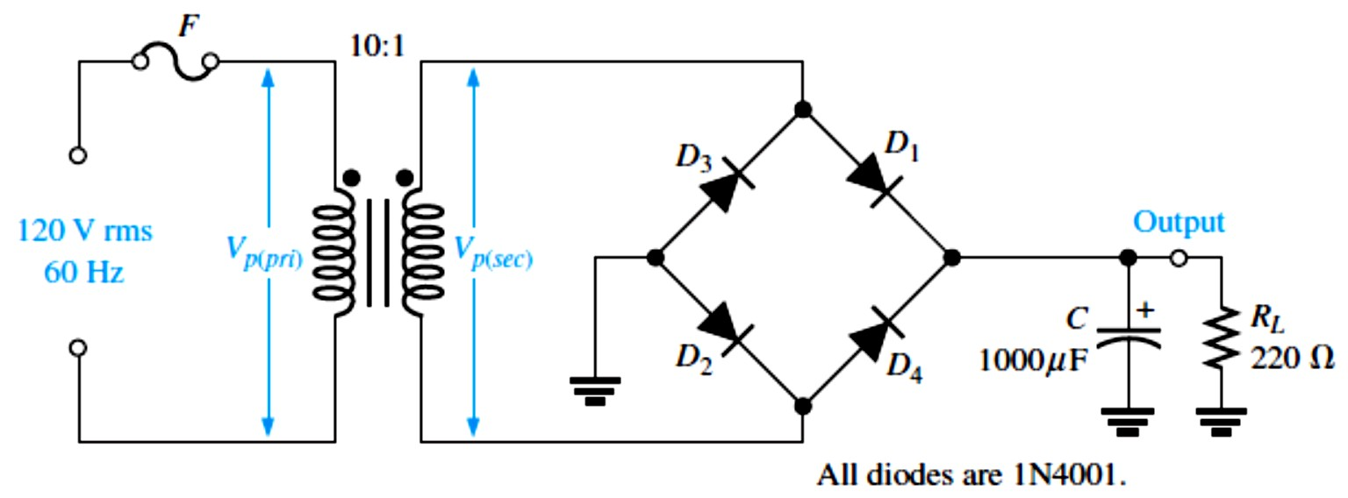
EXAMPLE 2-8: Determine the ripple factor for the filtered bridge rectifier with a load as indicated in Figure 2-23.
FIGURE 2-23
Solution The transformer turns ratio is n = 0.1. The peak primary voltage is
�_{�(��𝑖)} = 1.414 V��� = 1.414 (120V) = 170 V
The peak secondary voltage is
�_{�(���)} = 𝑛𝑉_{𝑃(𝑝𝑟𝑖)} = 0.1(170V) = 17 V
The unfiltered peak full-wave rectified voltage is
�_{�(����)} = �_{�(���)} − 1.4V = 17V − 1.4V = 15.6 V
The frequency of a full-wave rectified voltage is 120 Hz. The approximate peak-to-peak ripple voltage at the output is
1 1
) 15.6V = 0.591 V
^{��(��) ≅ (}𝑓𝑅�^{) ��(����) = (}(120Hz)(220Ω)(1000μF)
𝐿
The approximate dc value of the output voltage is determined as follows:
1 1
^{��� ≅ (1 −} 2𝑓𝑅�^{) ��(����) = (1 −} (240Hz)(220Ω)(1000μF)^{) 15.6V = 15.3 V}
𝐿
The resulting ripple factor is
𝑟=
��(��)
0.591 V
= _{15.3 V} = 0.039
𝑉
��
The percent ripple is 0.039× 100% =3.9%.
EXAMPLE 2-9: A certain 7805 regulator has a measured no-load output voltage of 5.18 V and a full load output of 5.15 V. What is the load regulation expressed as a percentage?
Solution
𝐋�𝐚� 𝐫�𝐠�𝐥𝐚�𝐢�� = (
���^{− �}𝐹�
5.18V − 5.15V
𝑉
) 100% = ( ) 100% = 0.58%
𝐹�
5.15V

Slide 15
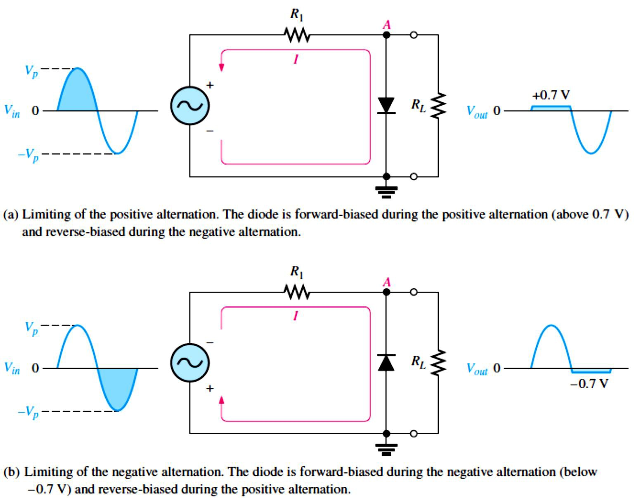
2.7 Diode Limiters and Clampers
Diode limiters or clippers cut off signal voltage above or below certain levels.
Figure 2-24(a) shows a diode positive limiter or clipper that limits or clips the positive part of the input voltage.
  The output voltage looks like the negative part of the input voltage, but with a magnitude:
𝑅_{𝐿}
���� ⁼ ⁽_{𝑅+ 𝑅}^{) �}𝑖�
1 𝐿
Figure 2-24(b) shows a diode negative limiter or clipper that limits or clips the negative part of the input voltage.
FIGURE 2-24: Examples of diode limiters (clippers).
Diode clampers add or restore a dc level to an ac voltage.
Figure 2-25 shows a diode clamper that inserts a positive dc level in the output waveform.
If the diode is turned around, a negative dc voltage is added to the input voltage to produce the output voltage as shown in Figure 2-26.

Slide 16
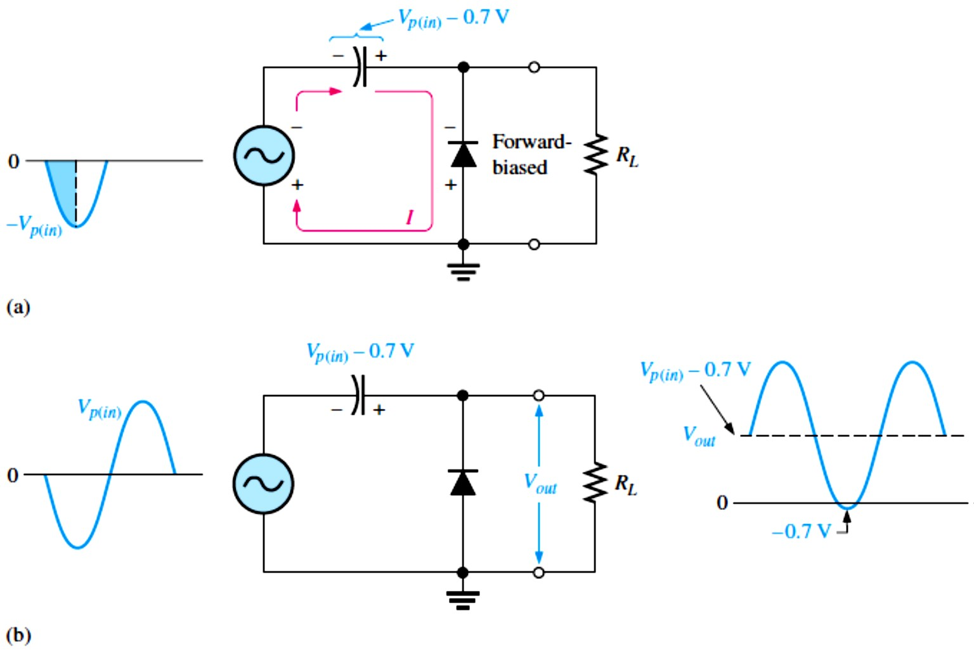
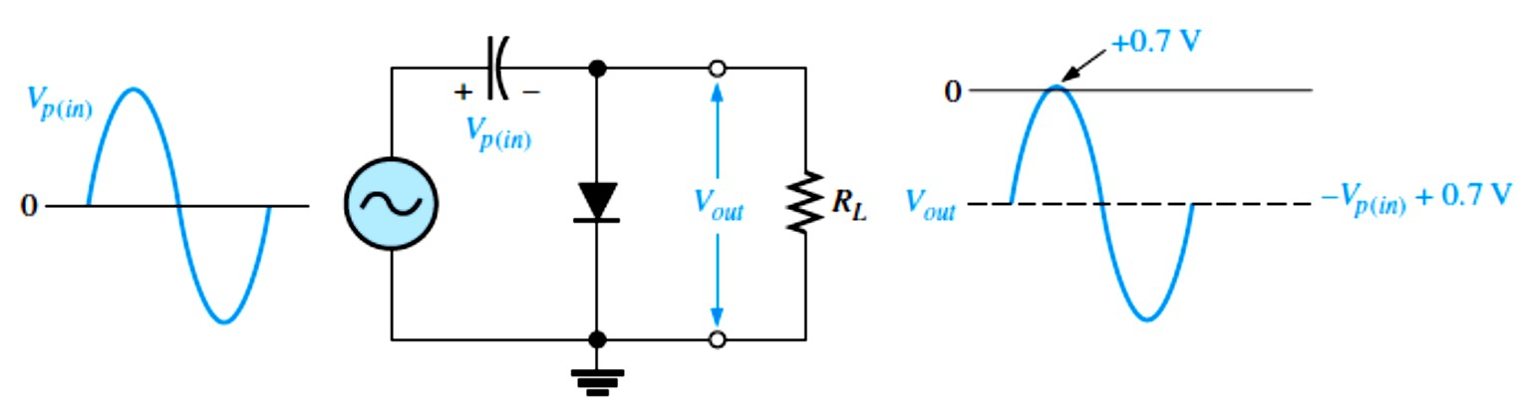
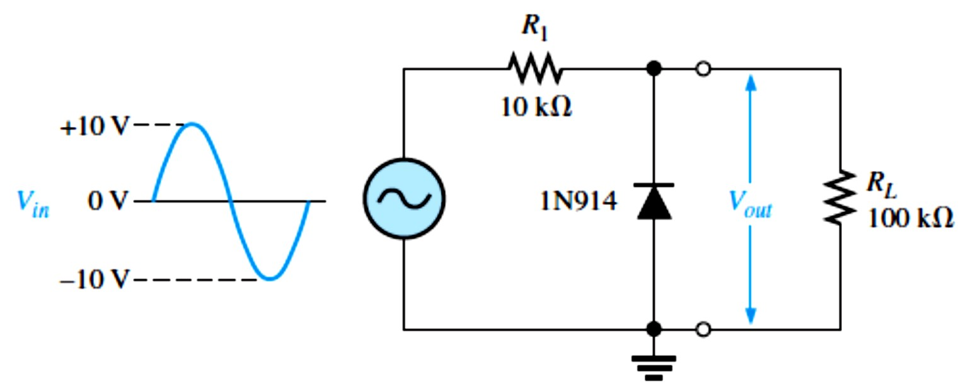
FIGURE 2-25: Positive clamper operation.
FIGURE 2-26: Negative clamper.
EXAMPLE 2-10: What would you expect to see displayed on an oscilloscope connected across
𝑅_{𝐿}in the limiter shown in Figure 2-27?
FIGURE 2-27

Slide 17
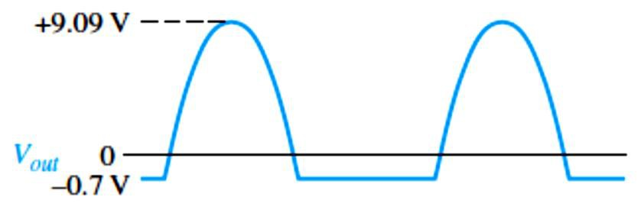
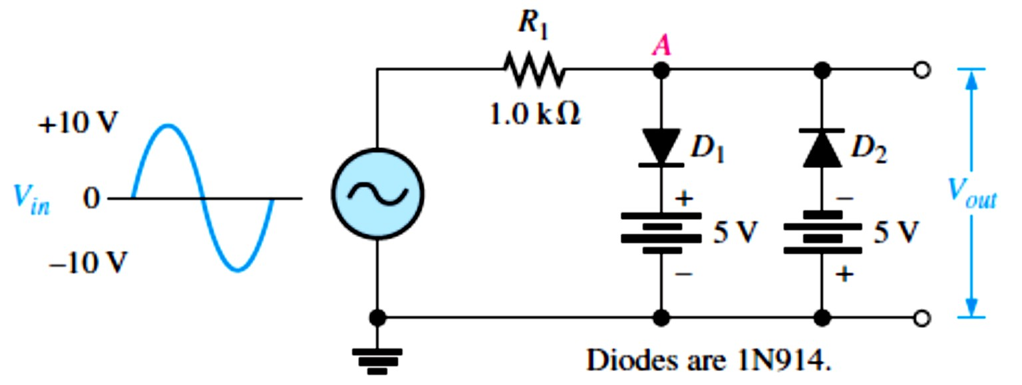
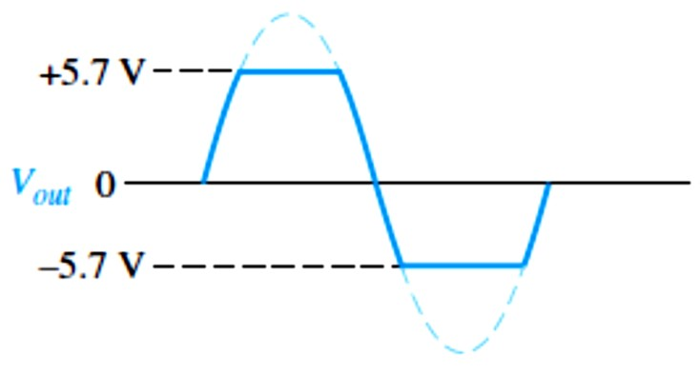
Solution The diode is forward-biased and conducts when the input voltage goes below −0.7V. So, for the negative limiter, we determine the peak output voltage across 𝑅_{𝐿}by the following equation:
��(���) ⁼ ⁽_{𝑅}
𝑅_{𝐿}
100kΩ
) 10V = 9.09 V
+ 𝑅^{) ��(𝑖�) = (}10kΩ + 100kΩ
1 𝐿
The scope will display an output waveform as shown in Figure 2-28.
FIGURE 2-28: Output voltage waveform for Figure 2-27.
EXAMPLE 2-11: Figure 2-29 shows a circuit combining a positive limiter with a negative limiter. Determine the output voltage waveform.
FIGURE 2-29
Solution When the voltage at point A reaches +5.7 V, diode �₁ conducts and limits the waveform to +5.7 V. Diode �₂ does not conduct until the voltage reaches −5.7 V. Therefore, positive voltages above +5.7 V and negative voltages below −5.7 V are clipped off. The resulting output voltage waveform is shown in Figure 2-30.
FIGURE 2-30: Output voltage waveform for Figure 2-29.

Slide 18
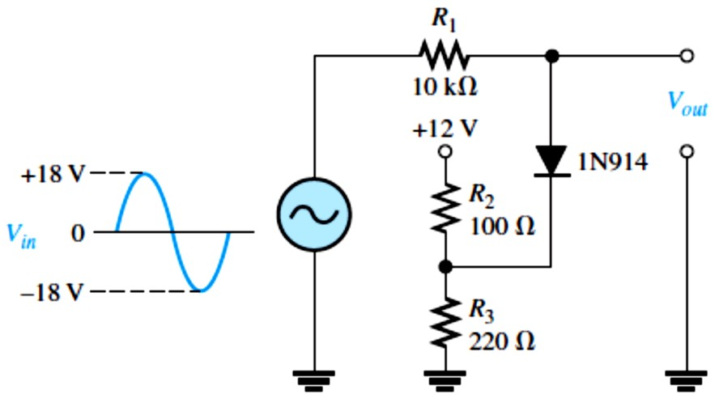
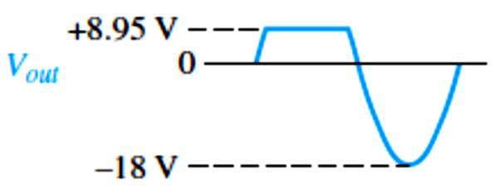
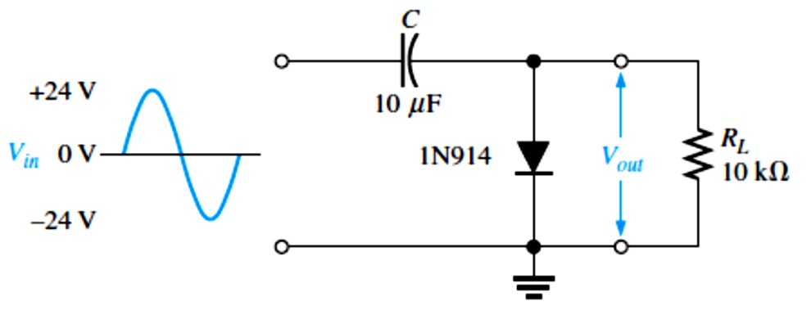
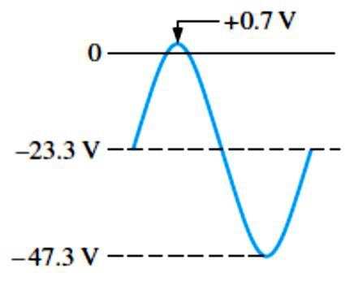
EXAMPLE 2-12: Describe the output voltage waveform for the diode limiter in Figure 2-31.
FIGURE 2-31
Solution The circuit is a positive limiter. Use the voltage-divider formula to determine the bias voltage.
�_{BIAS} = (𝑅₃⁄(𝑅₂ + 𝑅₃))�_{SUPPLY} = (220Ω⁄(100Ω + 220Ω))12V = 8.25 V
The output voltage waveform is shown in Figure 2-32. The positive part of the output voltage waveform is limited to �_{BIAS} + 0.7 V.
FIGURE 2-32
EXAMPLE 2-13: What is the output voltage that you would expect to observe across 𝑅_{𝐿}in the clamping circuit of Figure 2-33? Assume that RC is large enough to prevent significant capacitor discharge.
FIGURE 2-33
Solution Ideally, a negative dc value equal to the input peak less the diode drop is inserted by the clamping circuit.
��� ≅ −(�_{�(𝑖�)} − 0.7V) = −(24V − 0.7V) = −23.3V
Actually, the capacitor will discharge slightly between peaks, and, as a result, the output voltage will have an average value of slightly less than that calculated above. The output waveform goes to approximately +0.7 V, as shown in Figure 2-34.
FIGURE 2-34: Output waveform across 𝑅_{𝐿}for Figure 2-33.

Slide 19
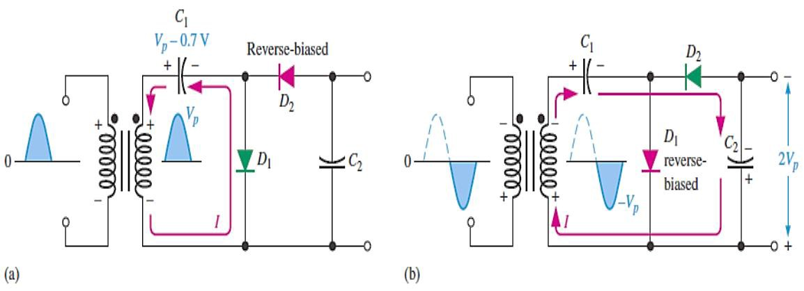
2.8 Voltage Multipliers
Voltage multipliers use clamping action to increase peak rectified voltages without the necessity of increasing the transformer’s voltage rating.
Voltage multipliers are used in high-voltage, low-current applications such as for electron beam acceleration in cathode-ray tubes (CRTs) and for particle accelerators.
A voltage multiplier uses a series of diode-capacitor stages.
Input voltage can be doubled, tripled, or quadrupled.
Voltage Doubler:
  Half-Wave Voltage Doubler: is a voltage multiplier with a multiplication factor of two, as shown in Figure 2-35.
  During the positive half-cycle of the secondary voltage, diode �₁ is forward-biased and �₂
is reverse-biased. Capacitor �₁ is charged to the peak of the secondary voltage (�� ) less the diode drop with the polarity shown in part (a).
  During the negative half-cycle, diode �₂ is forward-biased and �₁ is reverse-biased, as shown in part (b). Since �₁ can’t discharge, the peak voltage on �₁ adds to the secondary
voltage to charge �₂ to approximately 2�� . Applying Kirchhoff’s law around the loop as
shown in part (b), the voltage across �₂ is
�_{�1} − �_{�2} + �� = 0 → �_{�2} = �� + �_{�1}
Neglecting the diode drop of �₂, �_{�1} = �� . Therefore, �_{�2} = �� + �� = 2��
  Under a no-load condition, �₂ remains charged to approximately 2�� .
  If a load resistance is connected across the output, �₂ discharges slightly through the load on the next positive half-cycle and is again recharged to 2�� on the following negative half- cycle. The resulting output is a half-wave, capacitor-filtered voltage.
  The peak inverse voltage across each diode is 2�� .
  If the diode were reversed, the output voltage across �₂ would have the opposite polarity.
FIGURE 2-35: Half-wave voltage doubler operation. �� is the peak secondary voltage.

Slide 20
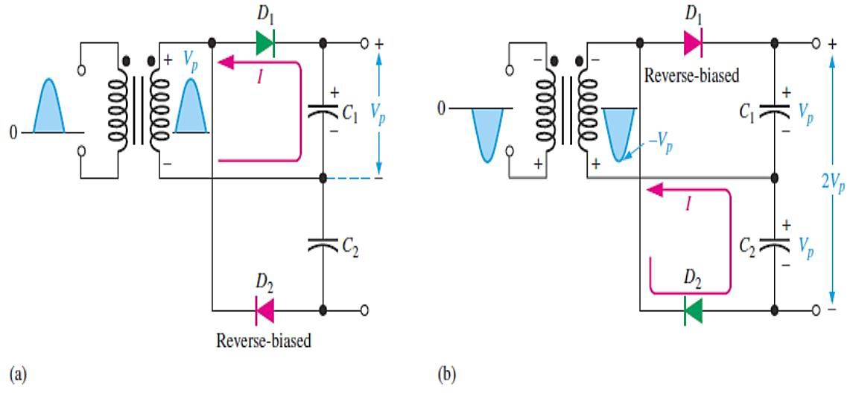
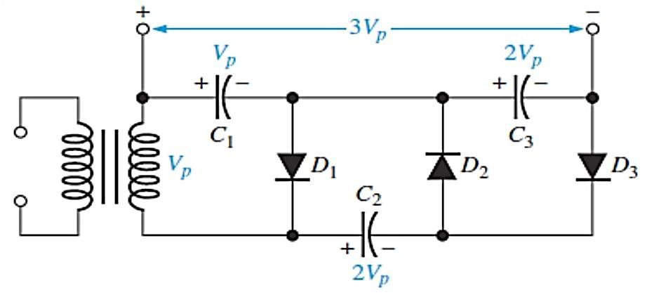
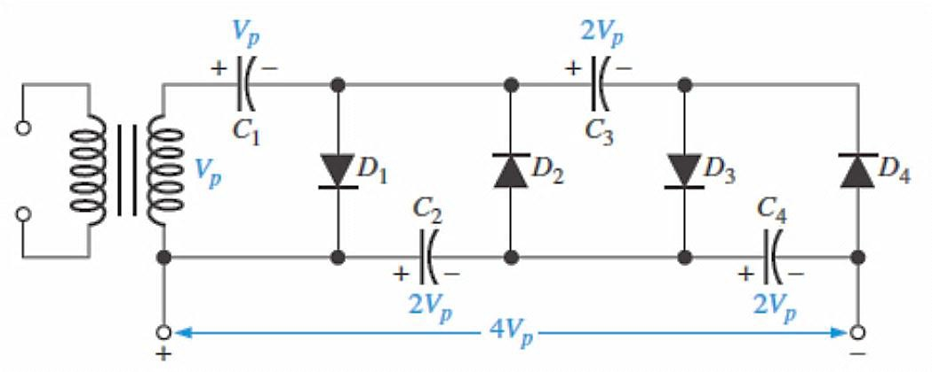
Full-Wave Voltage Doubler: is shown in Figure 2-36. When the secondary voltage is positive, �₁ is forward-biased and �₁ charges to approximately �� , as shown in part (a).
During the negative half-cycle, �₂ is forward-biased and �₂ charges to approximately �� , as shown in part (b). The output voltage, 2�� , is taken across the two capacitors in series.
FIGURE 2-36:
Full-wave voltage doubler operation.
Voltage Tripler: The addition of another diode-capacitor section to the half-wave voltage doubler creates a voltage tripler, as shown in Figure 2-37. The operation is as follows: On the positive half-cycle of the secondary voltage, �₁ charges to �� through �₁. During the negative halfcycle, �₂ charges to 2�� through �₂, as described for the doubler. During the next positive half-cycle, �₃ charges to 2�� through �₃. The tripler output is taken across �₁ and �₃, as shown in the figure.
FIGURE 2-37: Voltage tripler.
Voltage Quadrupler: The addition of still another diode-capacitor section, as shown in Figure 2-38, produces an output four times the peak secondary voltage. �₄ charges to 2�� through �₄ on a negative half-cycle. The 4�� output is taken across �₂ and �₄, as shown. In both the tripler and quadrupler circuits, the PIV of each diode is 2�� .
FIGURE 2-38:
Voltage quadrupler.
20

